Slide 1
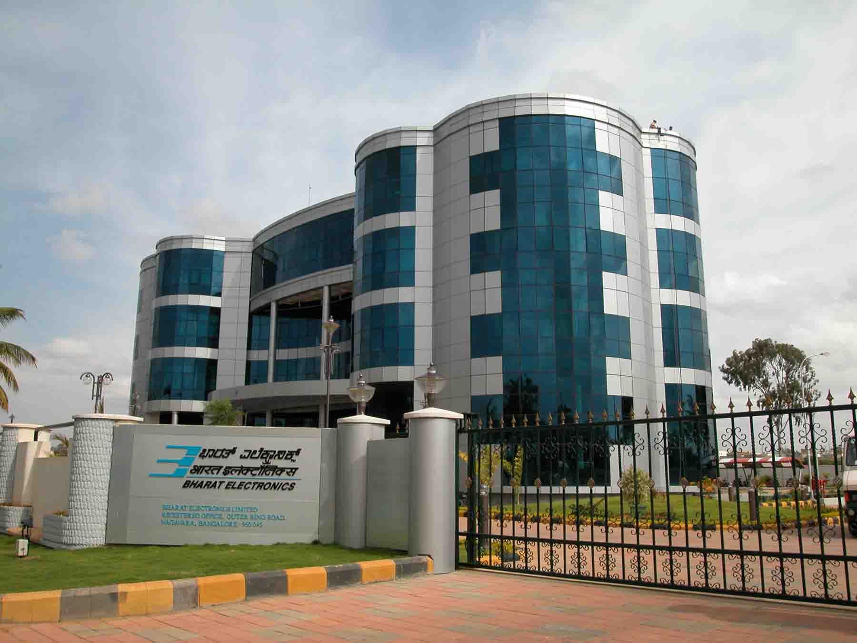
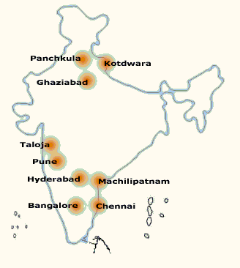
Bharat Electronics
www.bel-india.in

Slide 2
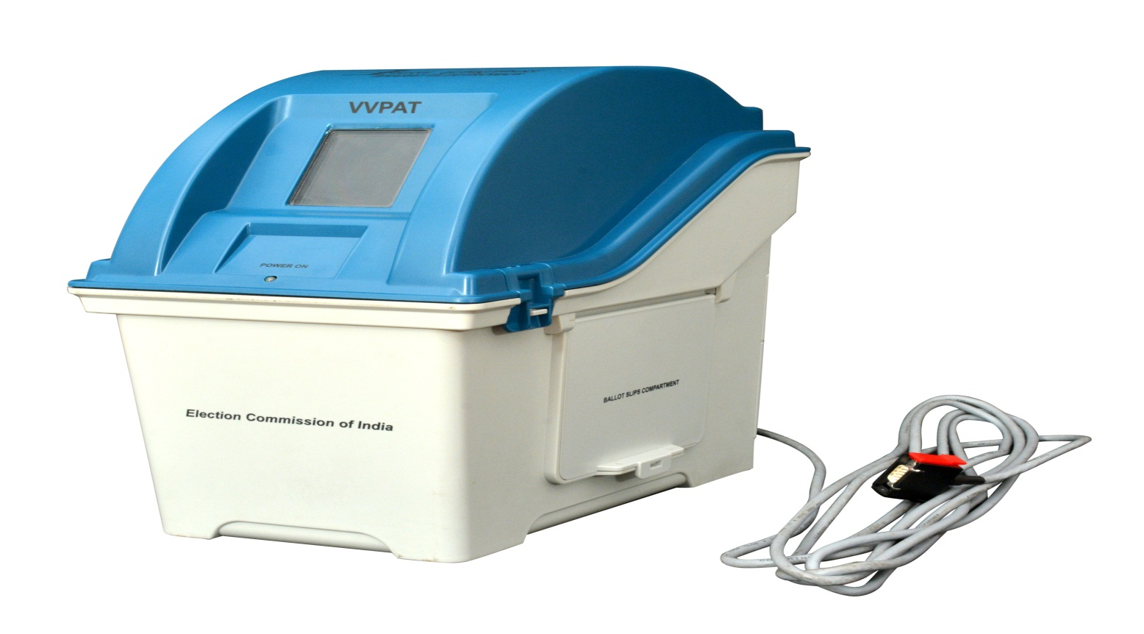
VVPAT
Features of
M3 VOTER VERIFIABLE PAPER AUDIT TRAIL
(VVPAT - M3)

Slide 3
VVPAT
Features of M3 VVPAT

Slide 4
VVPAT - Introduction
The elections in India are currently held using EVMs and counting is based on the results obtained in the EVM.
The purpose of the Voter Verifiable Paper Audit Trail (VVPAT) System is to print the selection of the voter on a slip for the voter to visually verify the vote cast.
Voter Verifiable Paper Audit Trail (VVPAT) system is a printer based accessory used in the set up of Electronic Voting Machine (EVM).
The VVPAT system prints the voter’s franchise on a thermal paper ballot slip for voter verification when EVMs are used in elections as well as an audit trail.
Introduction of the VVPAT

Slide 5
VVPAT- features
Special Features of the VVPAT
When the VVPAT system is used in combination with the EVM, it provides verification to the voter by way of printing the cast vote on a thermal paper ballot slip.
When the voter presses the button on the Ballot Unit (BU) to vote for the candidate of his / her choice, the VVPAT system prints a ballot slip of size 99 mm length.
The printed ballot slip is visible to the voter for a period of 7 seconds through a screen window available on VVPAT.
The ballot slip is then cut by the VVPAT unit and made to fall into the Ballot Slip compartment.

Slide 6
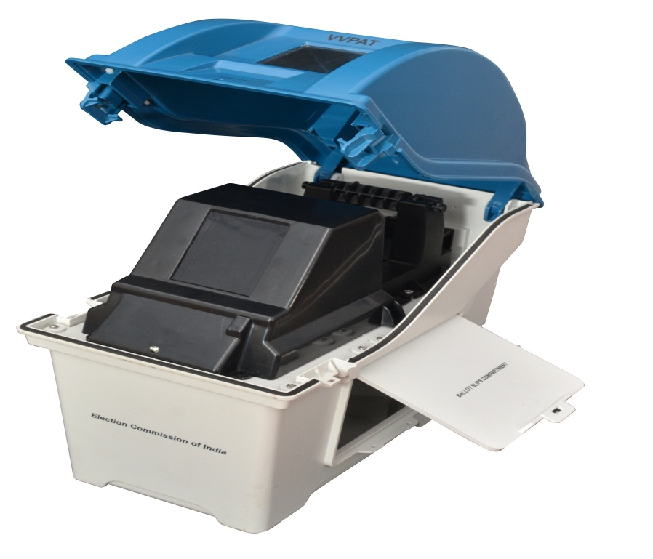
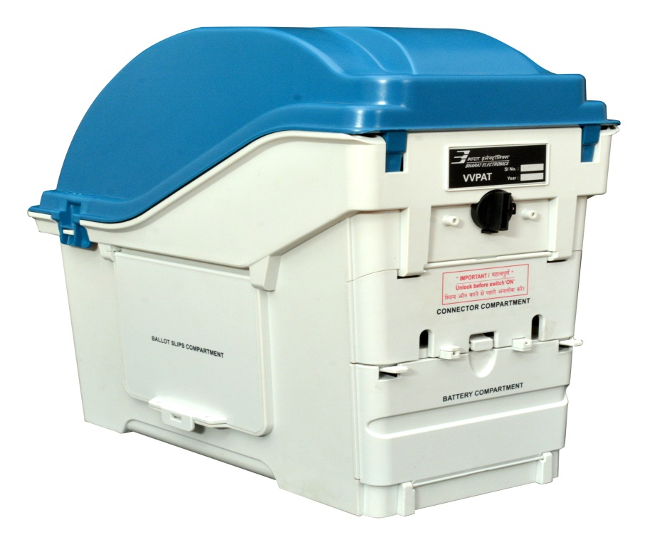
VVPAT- features
VVPAT system consists of four independent compartments,
namely :
(i) Paper roll compartment (ii) Ballot slips compartment
(iii) Battery compartment (iv) Connector compartment
Special Features of the VVPAT

Slide 7
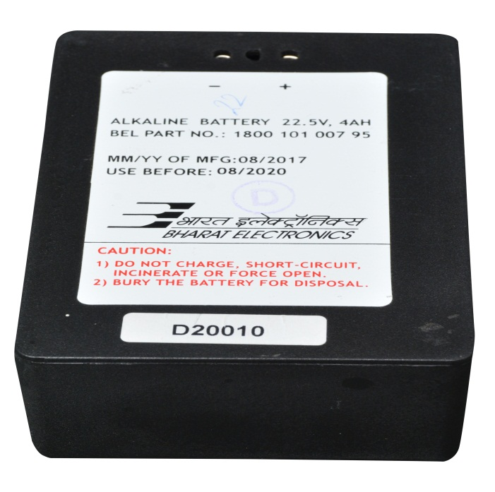
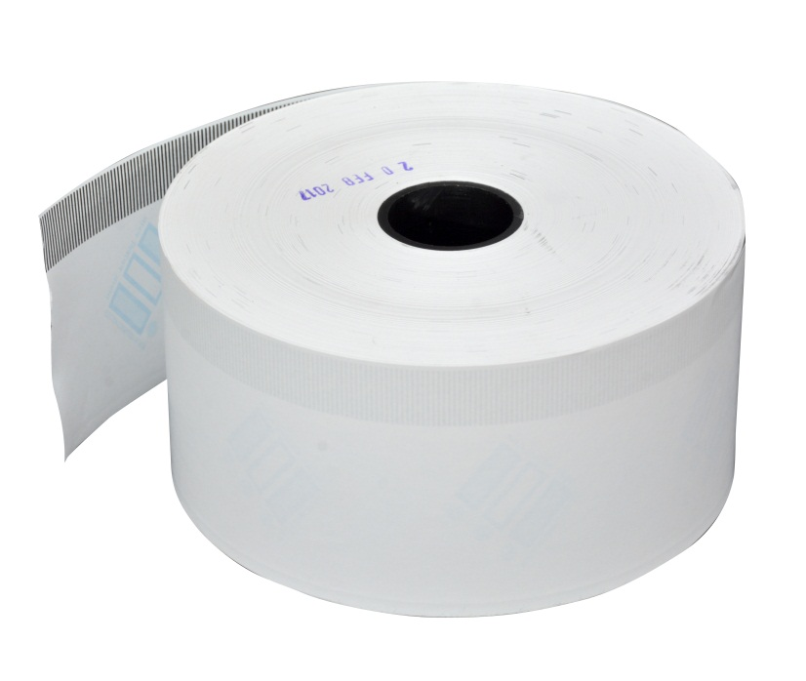
VVPAT- features
Prints the ballot slip of size 56 x 99 mm
Operates on a battery pack (22.5 V / 4 Ah)
Accommodates paper roll of length 150 meters or less
Special Features of the VVPAT

Slide 8
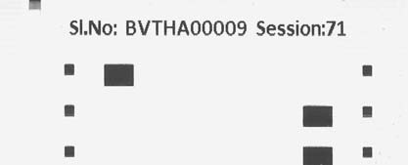
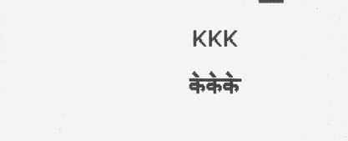
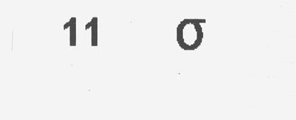
VVPAT – Ballot Slip
Ballot slip contains Information's:
Serial number of the contesting candidate
Name of the candidate selected
Corresponding election symbol
Serial number of the VVPAT unit
Poll session number

Slide 9
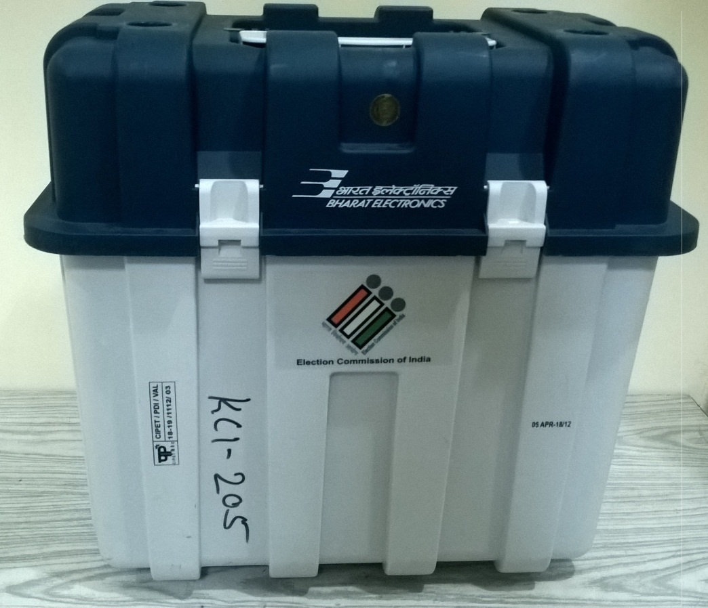
VVPAT – Carrying Cases
Carrying Case - VVPAT
VVPAT is packed separately in special carrying cases
To Open the Carrying case, Lift front and side latch

Slide 10
VVPAT – Front View
Transparent Window
Power ON LED
Ballot Slip Compartment
The Interconnecting cable is permanently attached to the VVPAT Unit
Front View

Slide 11
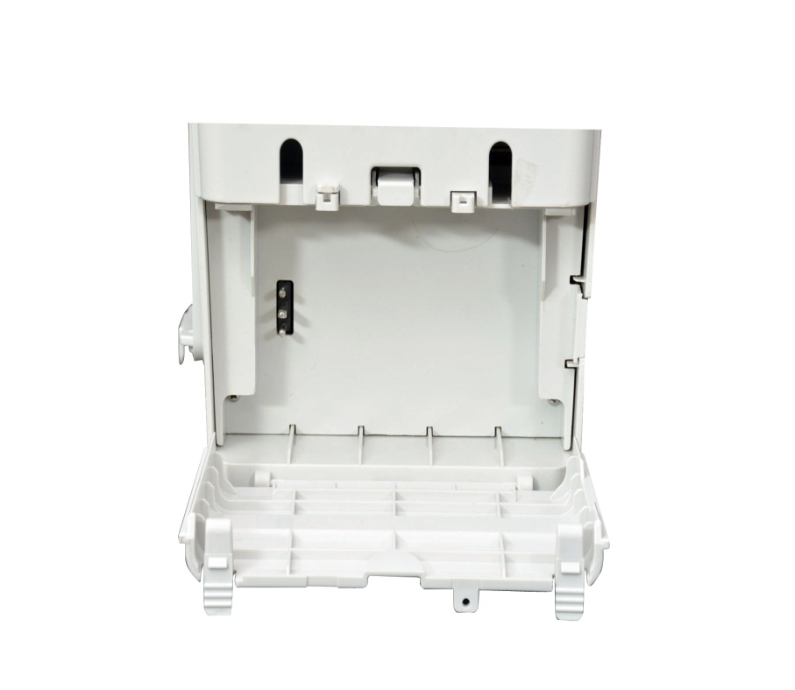
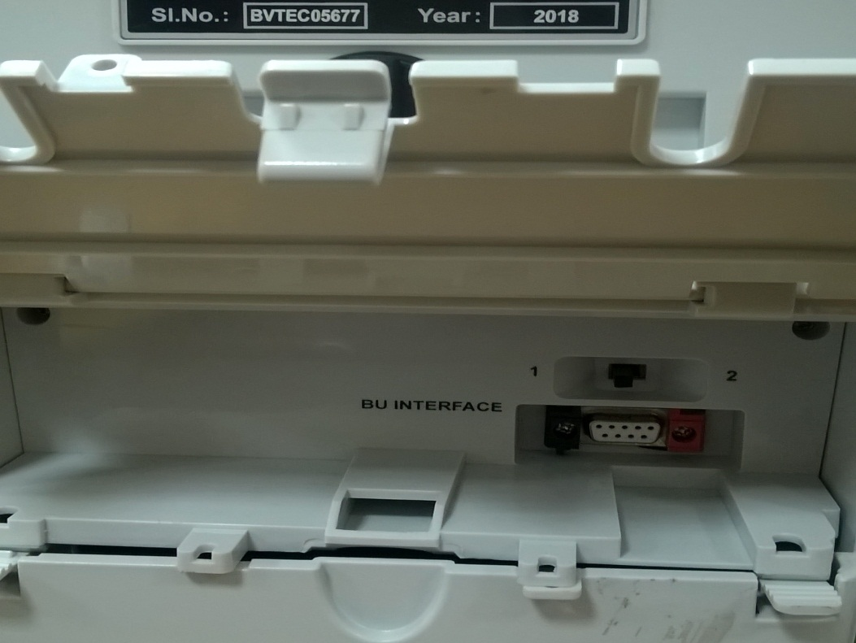
VVPAT– Rear View
Connector and Battery Compartment
Battery
Compartment
Connector
Compartment
BU interface
Battery Plug
VVPAT Position Switch

Slide 12
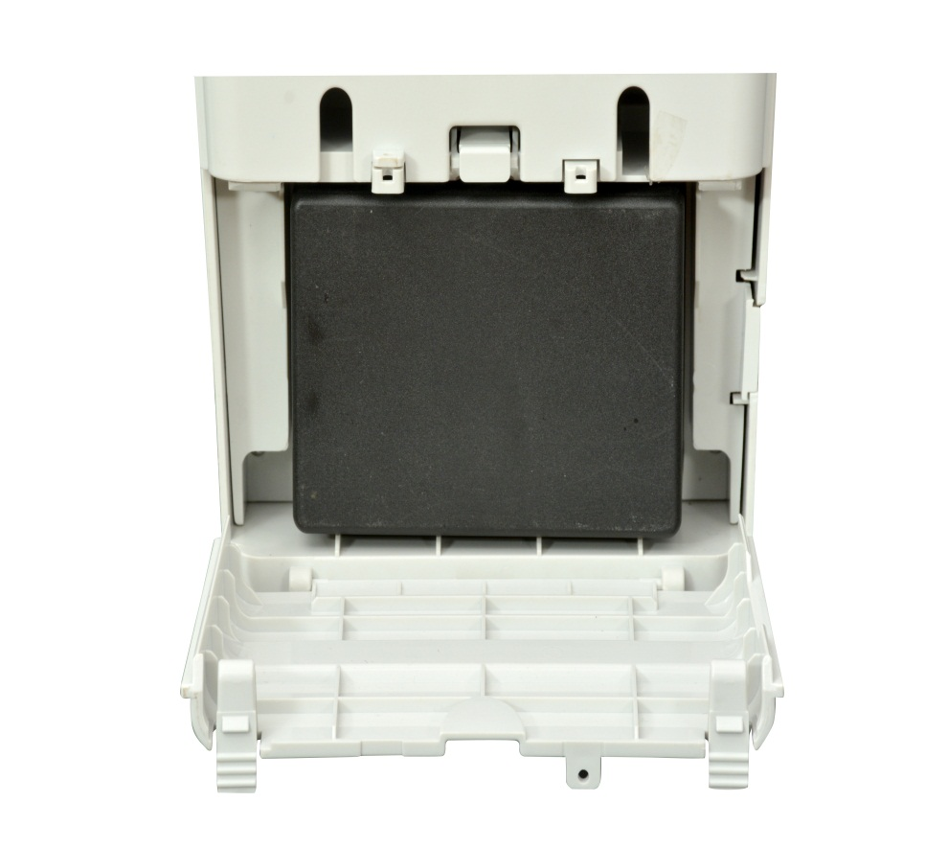
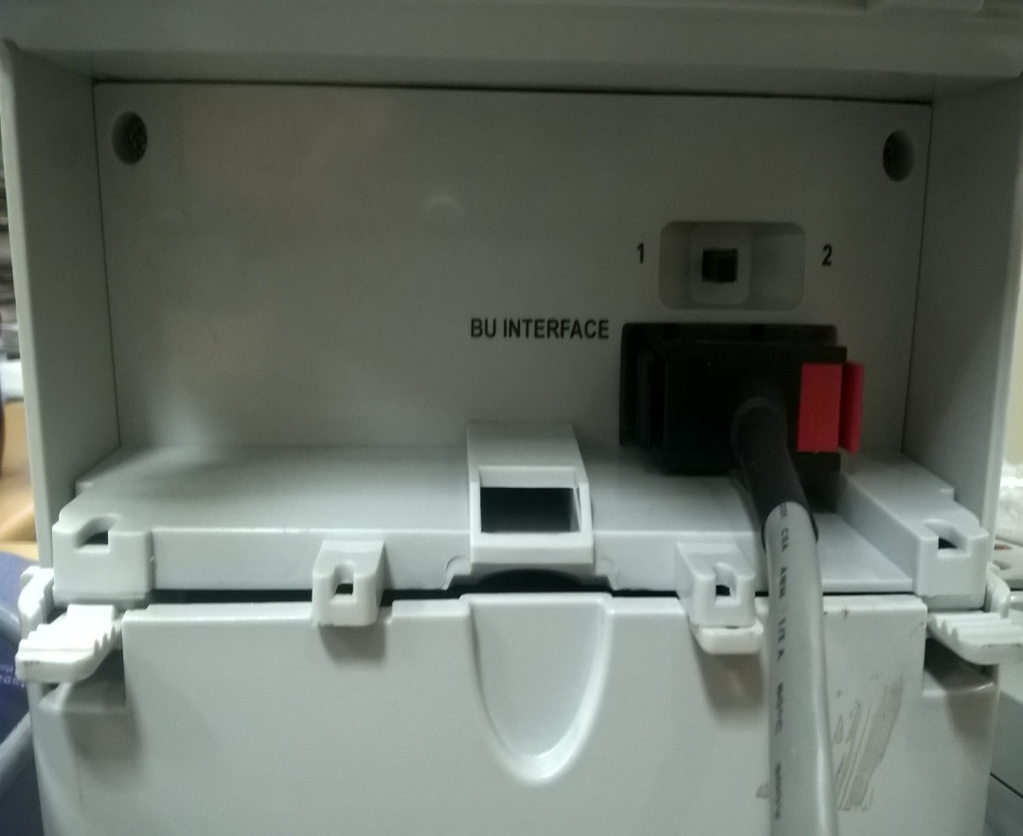
VVPAT- Rear View
Battery Insertion
BU cable connected
Position Switch in 1(Left side

Slide 13
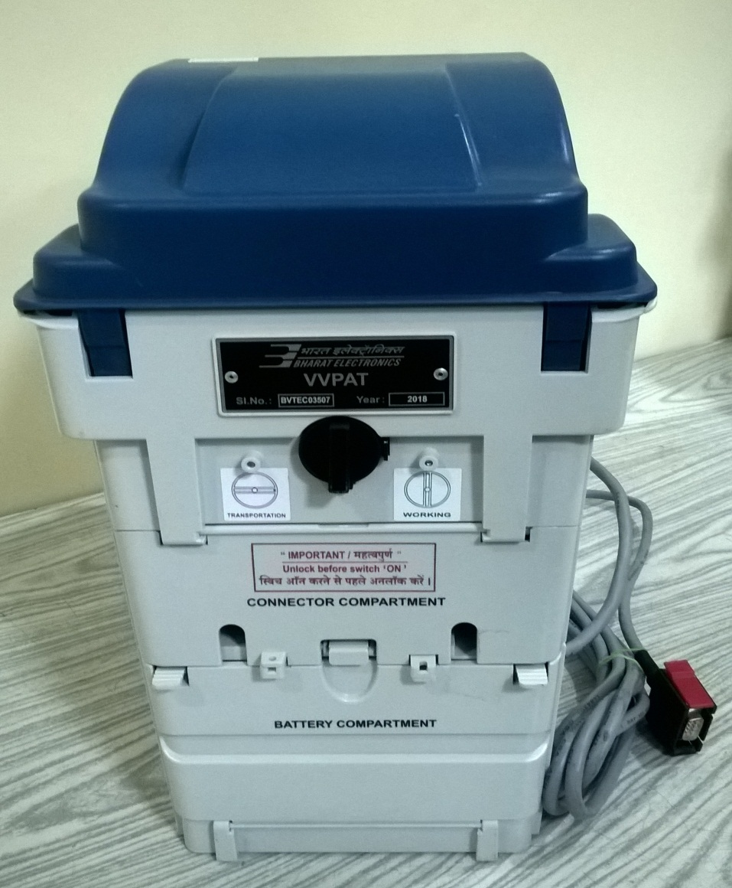
VVPAT–Rear View
Lock-Unlock Knob
Keep know vertical while using VVPAT
Keep know horizontal while
transporting VVPAT
Stickers for Indication

Slide 14
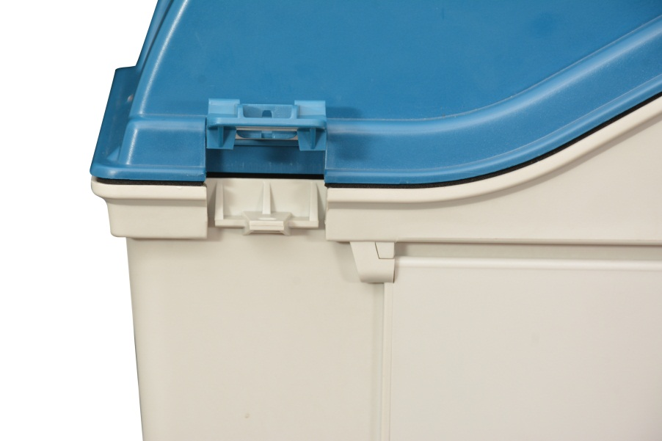
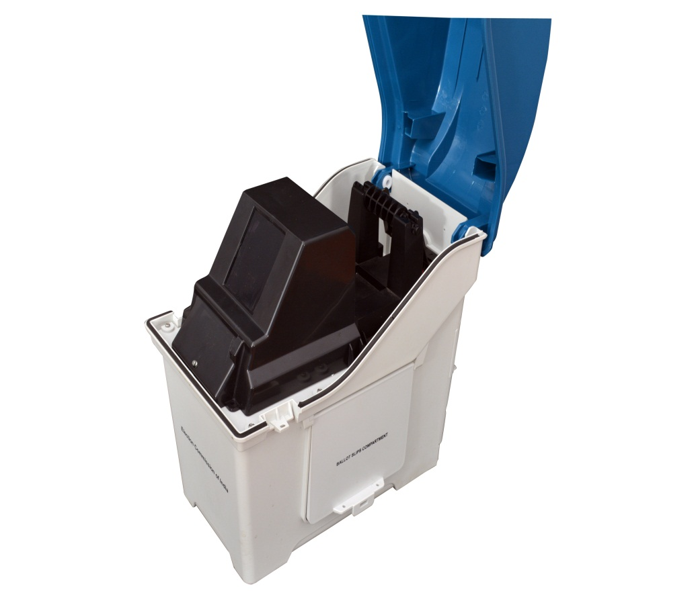
VVPAT – Opening of Paper Compartment
Lift side Latch to
open Compartment
Paper Compartment
after opening

Slide 15
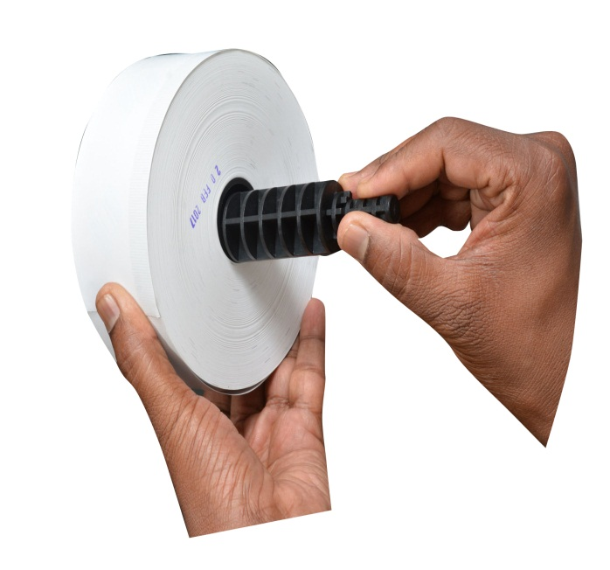
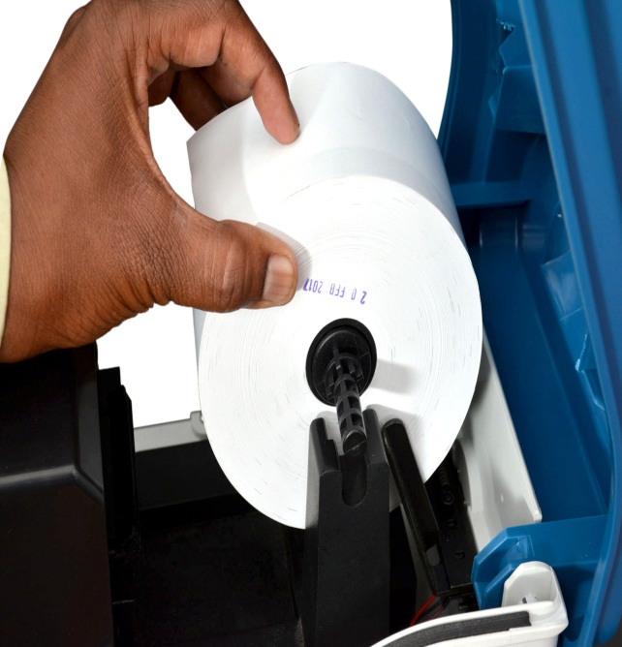
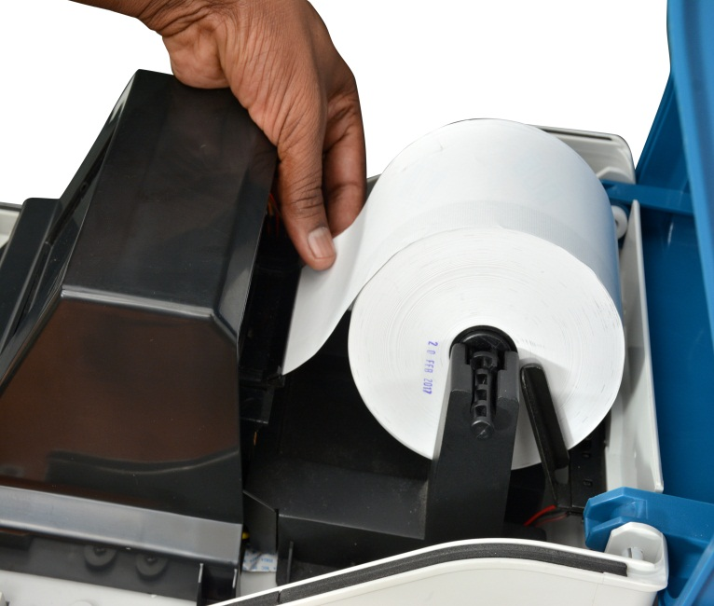
VVPAT
Loading of Paper Rolls
Insert spindle into
Paper Roll
Press down Paper Roll into space provided
Insert Paper into
Paper Guide

Slide 16
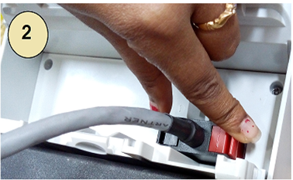
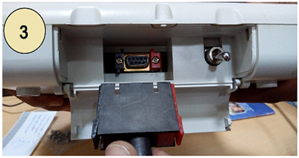
VVPAT Connection
Open connector compartment of VVPAT
Connect cable from Ballot Unit to BU Interface connector matching the coloured latches (red/black connector)
Connect VVPAT cable to BU interface connector of Control Unit matching the coloured latches (red/black connector)

Slide 17
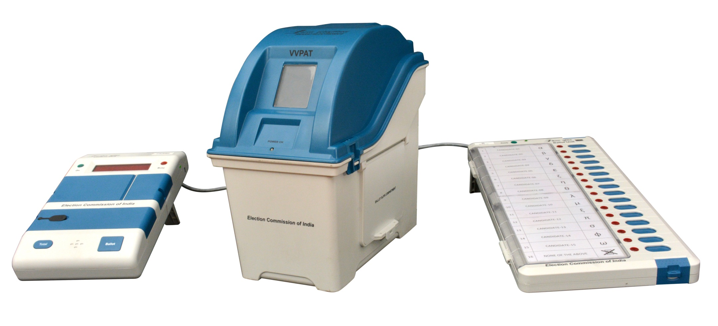
VVPAT
VVPAT setup with CU and BU

Slide 18
VVPAT
THANK YOU
www.bel-india.in

